Slide 1
Basic CSS

Slide 2
What is CSS ?
CSS stands for Cascading Style Sheets.
It is a stylesheet language used to describe the presentation and design of a document written in HTML

Slide 3
What CSS does?
CSS controls how elements appear on a webpage — such as:
🖋️ Fonts (style, size, color)
🎨 Colors (text, background, borders)
📐 Layouts (spacing, positioning, alignment)
📱 Responsiveness (how it looks on different screen sizes)

Slide 4
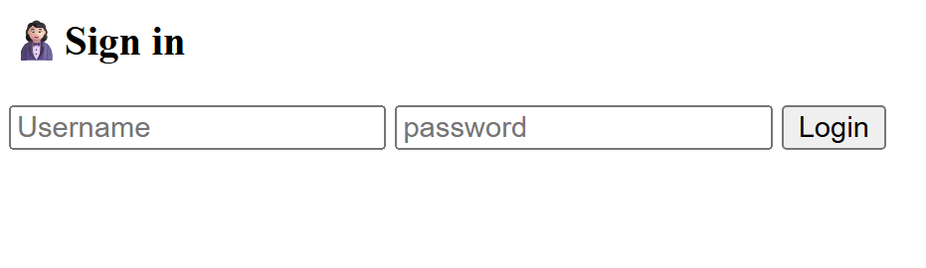

Without CSS
With CSS

Slide 5
Text and font properties
Property | Example Value | Demo
color | red, #0000ff | ABC → ABC
font-size | 16px, 1em | ABC → ABC
font-family | Arial, sans-serif, cursive | ABC → ABC
font-weight | bold, normal | ABC → ABC
text-align | left, center | ABC | ABC
text-decoration | underline, none , overline | ABC → ABC

Slide 6
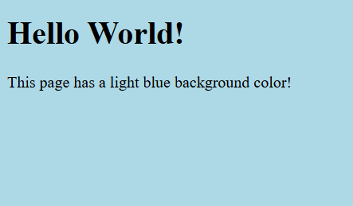
Background properties
CSS background-color
<!DOCTYPE html>
<html>
<head>
<style>
body {
background-color: lightblue;
}
</style>
</head>
<body>
<h1>Hello World!</h1>
<p>This page has a light blue background color!</p>
</body>
</html>

Slide 7
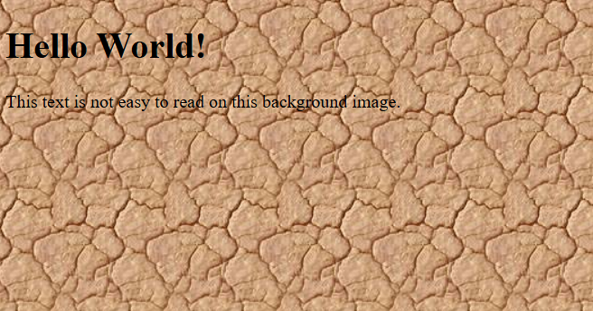
background-image
body {
background-image: url("bgdesert.jpg");
}

Slide 8


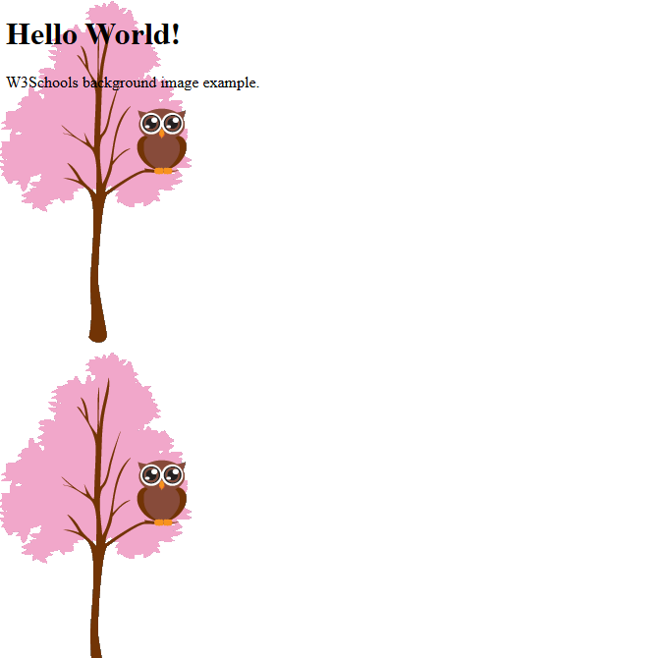
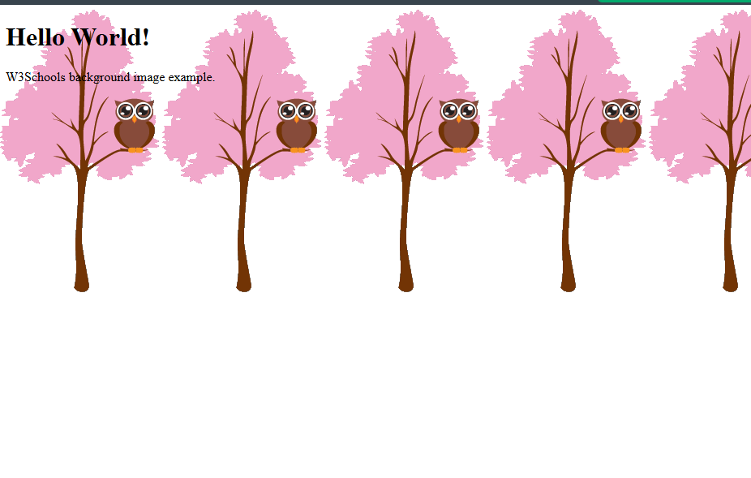
background-repeat

Slide 9
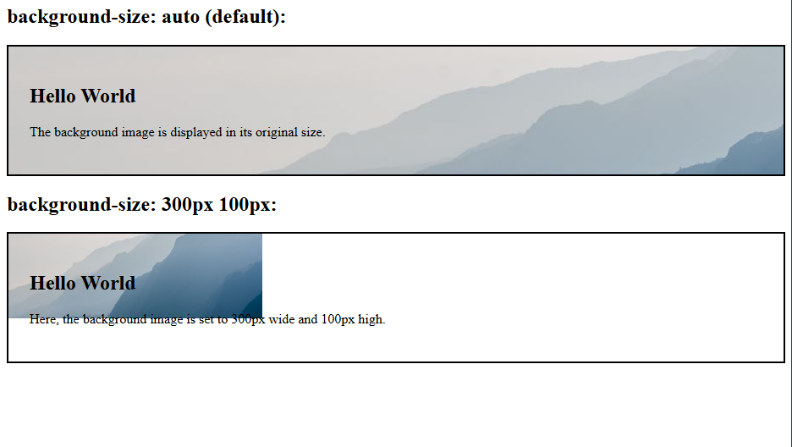
background-size

Slide 10
Any Queries?

